Slide 1
MOVIE RECOMMENDATION

Slide 2

Olsi Mosha

Slide 3

History & Milestones
Founded by Reed Hastings and Marc Randolph in 1997, Scotts Valley, California.
Operated initially as a DVD rental-by-mail service.
Introduced a monthly subscription for unlimited DVD rentals in 1999.
Went public on May 23, 2002, at $15 per share.
Began offering streaming content in 2007.
Went international in 2010, starting with Canada.
03

Slide 4

Streaming Leader
Operates in over 190 countries with 230+ million subscribers
Produces movies, series, documentaries, and specials in various genres and languages.
Has won multiple Oscars, Emmys, and Golden Globes for its original content.
Offers interactive content, personalized recommendations, and high-quality streaming (4K, HDR, Dolby Atmos).
Competes with Disney+, Amazon Prime Video, HBO Max, and Apple TV+.
04

Slide 5


Recommendation Systems
Yesterday: Basic Recommendation System
Today : Advanced Recommendation System
Machine Learning and AI
Sophisticated machine learning and AI algorithms.
Hybrid Models
Filtering using content metadata and user behavior.
Global Reach
Provides region-specific recommendations and multi-language support.
Cinematch Algorithm: User ratings
Netflix Competition (2006-2009): Improve Cinematch's accuracy by 10%. (team "BellKor's Pragmatic Chaos.")
05

Slide 6


Data Sources
Kaggle
Kaggle
Netflix Movies and TV Shows Dataset
Shape (8806,12)
Netflix Movies and TV Shows Dataset
Shape (6234,12)
OMDb API
06

Slide 7
Project Structure
Data Cleaning
Visualization Tableau
Streamlit
Recommendation System
Machine Learning
07

Slide 8
Data Cleaning
1.
Handle Missing Values: Identify and fill or drop missing data
2.
Categorize Movies: Organize movie categories for consistency
3.
Modify Ratings: Adjust and normalize ratings as needed
4.
Join Datasets: Merge datasets into one comprehensive dataset
08

Slide 9


Visualization
Let’s jump to Tableau
09

Slide 10
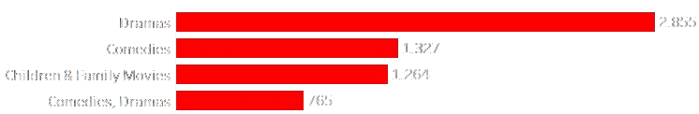
Data Statistics
In 2019, Netflix significantly expanded its library, adding 2,583 movies and 68 TV shows, marking it as a peak year for new content additions.
The distribution of content on Netflix consists of approximately 97.33% movies and 2.67% TV shows
TOP GENRES
Drama, Comedies, Children & Family Movies, Comedies & Dramas
10

Slide 11
My Recommendation System
BERTopic Algorithm :
Recommendation systems in streaming platforms
Customer support chatbots
Processes large datasets and identifies subtle word connections.
Netflix Spotify Google
TF-IDF Algorithm :
Search engines like Google
Email spam filters use TF-IDF to identify suspicious or irrelevant messages
Text summarization algorithms use TF-IDF
Amazon Microsoft Google
11

Slide 12
How the TF-IDF Algorithm Works
Database
Streamlit
OMDb API
TF-IDF
Cosine Similarity

Slide 13


Running the Streamlit App
Streamlit is a free tool that lets you create interactive web apps using Python. It's great for turning data projects into shareable web applications quickly and easily, without needing to know a lot about web development.
13

Slide 14

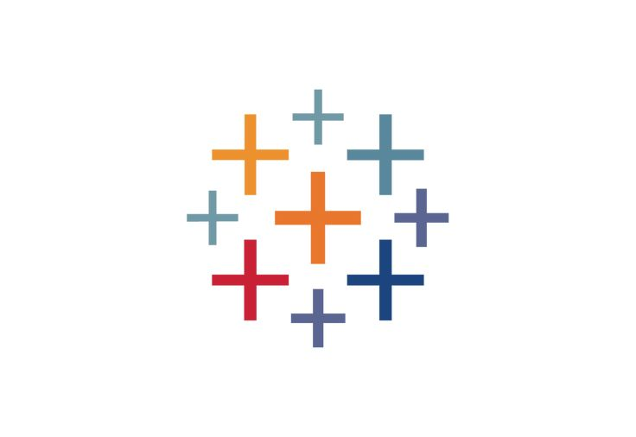

Explore the Project
Tableau Public
https://public.tableau.com/app/profile/olsi.mosha/viz/Netflix_17165568321350/Netflix?publish=yes
Github
https://github.com/olsi19/ironhack_final
14

Slide 15
THANK YOU
Olsi Mosha
15

